Slide 1
introduction to solver (linear programmimg)
BIT (UCU)

Slide 2
What is Solver?
Solver is an Add-In for spreadsheets which can solve optimization problems, including multiple constraint problems.
You can maximize, minimize, or set a target value to achieve.
Linear and non-linear solvers are available in most commercially available spreadsheets to include Excel, LibreOffice, GoogleSheets, etc.

Slide 3
outline
we will go step by step through the process of creating a Solver model, using a Product Mix example.
We'll first show you how to
(1) load the solver into your spreadsheet,
(2) define the problem and write out formulas for the objective and constraints, and
(3) solve the problem. We will focus on Microsoft Excel (Mac and PC) and LibreOffice.

Slide 4
Step 1: Loading the Solver Into Your Spreadsheet
The first step is to make sure you have the correct add-in or solver loaded into your spreadsheet. This process differs by Spreadsheet, operating system, and sometimes version!

Slide 5
Microsoft Excel for PC
Excel does not usually come with the solver loaded. It is considered an Add-In – it is available, you just need to download it. As with most Microsoft tools, it differs whether you are on a Mac or using a PC.
Click the Microsoft Office Button, and then click Excel Options.
Click Add-Ins, and then in the Manage box, select Excel Add-ins and click Go.

Slide 6
loading solver in Excel(PC) Cont'd
In the Add-Ins available box, select the Solver Add-in check box, and then click OK.
If Solver Add-in is not listed in the Add-Ins available box, click Browse to locate the add-in.
If you get prompted that Solver is not currently installed, click Yes to install it.
After you load Solver, the Solver command is available in the Analysis group on the Data tab.

Slide 7
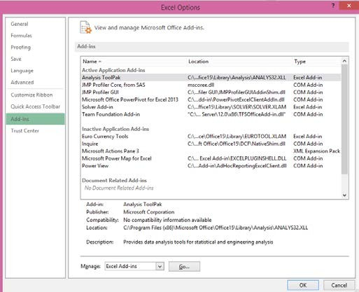
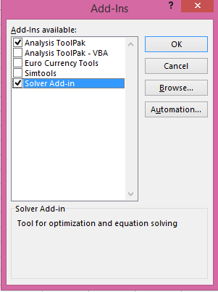
loading solver in Excel(PC) Cont'd

Slide 8
Microsoft Excel for MAC
Loading solver for the Mac differs a little depending on the version of Excel being used. For Excel for Mac 2011 and later, this process works:
Open Excel for Mac and begin by clicking on the Tools menu.
Click Add-Ins, and then in the Add-Ins box, check Solver.xlam and then click OK.

Slide 9
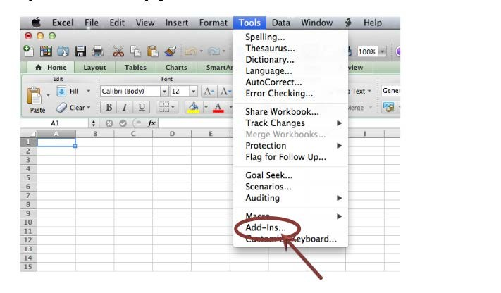
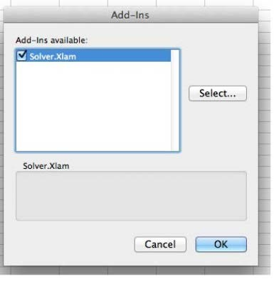
Loading solver for the Mac cont'd

Slide 10
Loading solver for the Mac cont'd
After restarting Excel for Mac (fully Quit Excel), select the Data tab, then select Solver to launch. Now on the Tools menu, you should see the Solver command.

Slide 11
solver in Libre office/Open office
The Solver is found at Tools -> Solver from the main menu.
The solver will then show up as a separate window. At the bottom left of this window you'll find an Options... -button.
Click this button and make sure LibreOffice Linear Solver is selected as the solver engine.

Slide 12
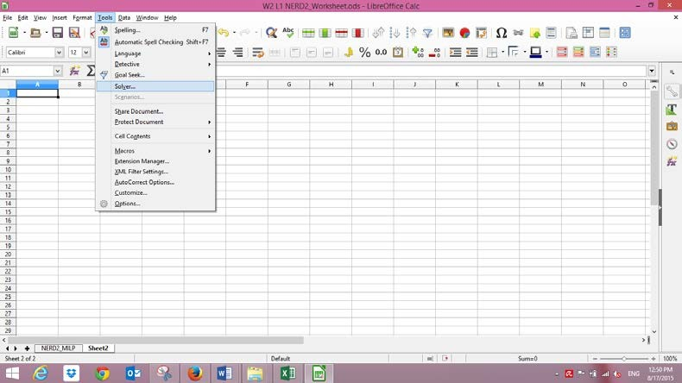
solver in libre office cont'd

Slide 13
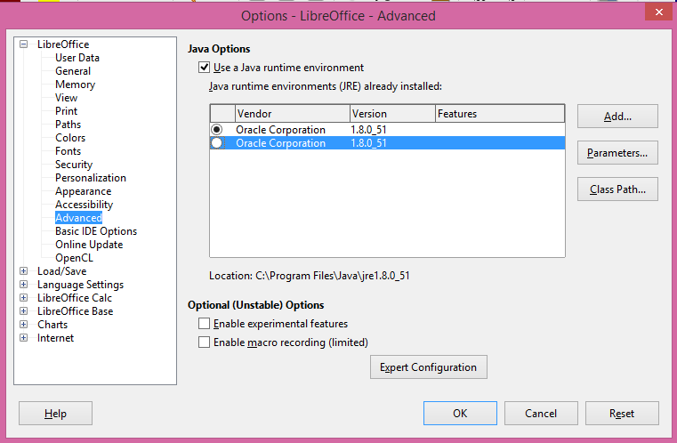
You might also need to define your JAVA JRE client (sometimes an error occurrs when launching the solver). In the same options tab, go to Advanced and select one of the Java Run time Environment installed on your computer and click OK

Slide 14
Step 2. Setting up the Problem
the Example Problem
Imagine that you manage a factory that produces four different types of wood paneling.
Each type of paneling is made by gluing and pressing together a different mixture of pine and oak chips.
The following table summarizes the required amount of gluing, pressing, and mixture of wood chips required to produce a pallet of 50 units of each type of paneling:

Slide 15
 | Resources Required per Pallet of Paneling Type
 | Tahoe | Pacific | Savannah | Aspen
Glue (quarts) | 50 | 50 | 100 | 50
Pressing (hours) | 5 | 15 | 10 | 5
Pine chips (pounds) | 500 | 400 | 300 | 200
Oak chips (pounds) | 500 | 750 | 250 | 500

Slide 16
In the next production cycle,
you have:
5,800 quarts of glue;
730 hours of pressing capacity;
29,200 pounds of pine chips;
and 60,500 pounds of oak chips available.
Further assume that each pallet of Tahoe, Pacific, Savannah, and Aspen panels can be sold for profits of $450,
$1,150, $800, and $400, respectively.

Slide 17
Before we implement this problem statement in either Excel, let's write out formulas corresponding to the verbal description above.
If we use the symbol X1 for the number of Tahoe pallets produced, X2 for the number of Pacific pallets produced, and X3 for the number of Savannah pallets produced, and X4 for the number of Aspen pallets produced, the objective (calculating total profit) is:

Slide 18
Maximize: 450 X1 + 1150 X2 + 800 X3 + 400 X4

Slide 19
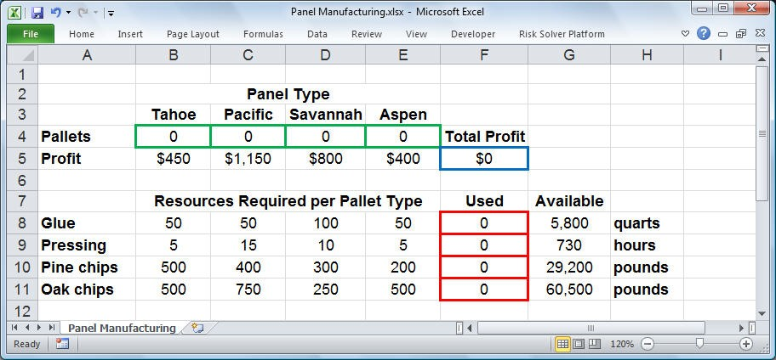

Slide 20
the Objective function on cell F5 is:
= SUMPRODUCT(B4:E4,B5:E5)
which is equivalent to :
= B5*B4+C5*C4+D5*D4+E5*E4

Slide 21
A pallet of each type of panel requires a certain amount of glue, pressing, pine chips, and oak chips.
The constraints for this problem are expressed as follows:

Slide 22
constraints
50 X1 + 50 X2 + 100 X3 + 50 X4 <= 5800 (Glue)
5 X1 + 15 X2 + 10 X3 + 5 X4 <= 730 (Pressing)
500 X1 + 400 X2 + 300 X3 + 200 X4 <= 29200 (Pine chips)
500 X1 + 750 X2 + 250 X3 + 500 X4 <= 60500 (Oak chips)

Slide 23
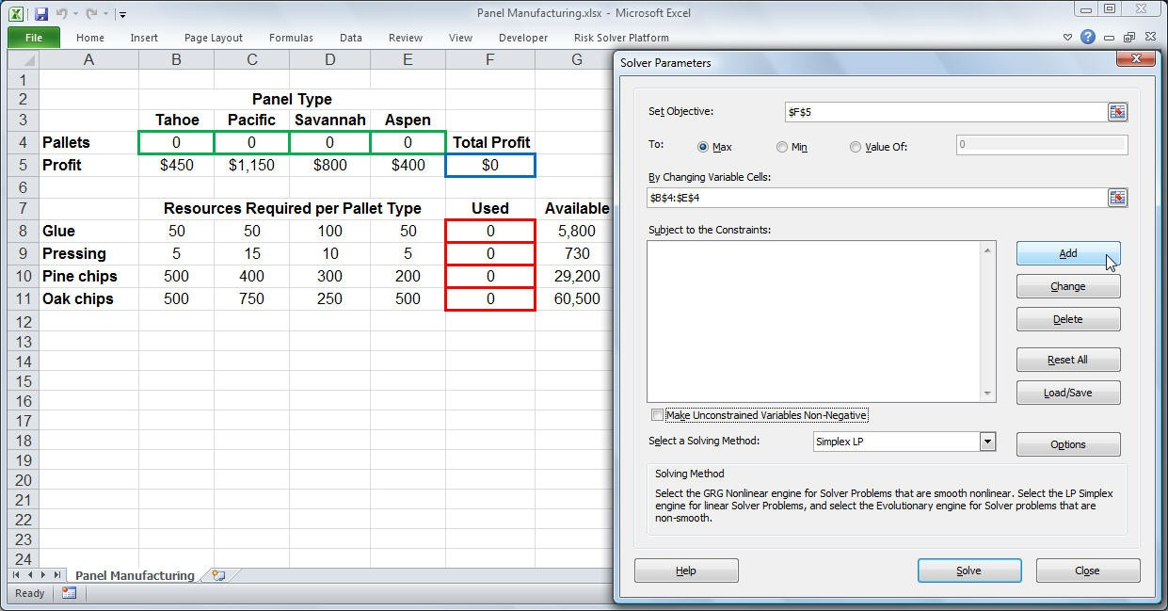

Slide 24
In cells B8:E11, we've entered the amount of resources needed to produce a pallet of each type of panel. Formula for cell F8: =SUMPRODUCT(B8:E8,$B$4:$E$4)
We can copy this formula to cells F9:F11 to compute the total amount of pressing, pine chips, and oaks chips used.

Slide 25
In cells G8:G11, we've entered the available amount of each type of resource (corresponding to the right hand side values of the constraints). This allows us to express the constraints shown earlier as: F8:F11<=G8:G11
Since the number of products built cannot be negative, we'll also have non-negativity conditions on the variables: X1, X2, X3, X4 >= 0.
We can enter this set of constraints directly in the Solver dialogs along with the non-negativity conditions: B4:E4 >= 0

Slide 26
Step 3.Solving the Problem(Excel)
To let the Excel Solver know which cells on the worksheet represent the decision variables, constraints and objective function, we click Solver button on the Excel Data tab.
In the Set Objective edit box, we type or click on cell F5, the objective function.
In the By Changing Variable Cells edit box, we type B4:E4 or select these cells with the mouse.

Slide 27
To add the constraints, we click on the Add button in the Solver Parameters dialog and select cells F8:F11 in the Cell Reference edit box (the left hand side), and select cells G8:G11 in the
Constraint edit box (the right hand side); the default relation <= is OK. (Click on the image to see it full-size.)

Slide 28
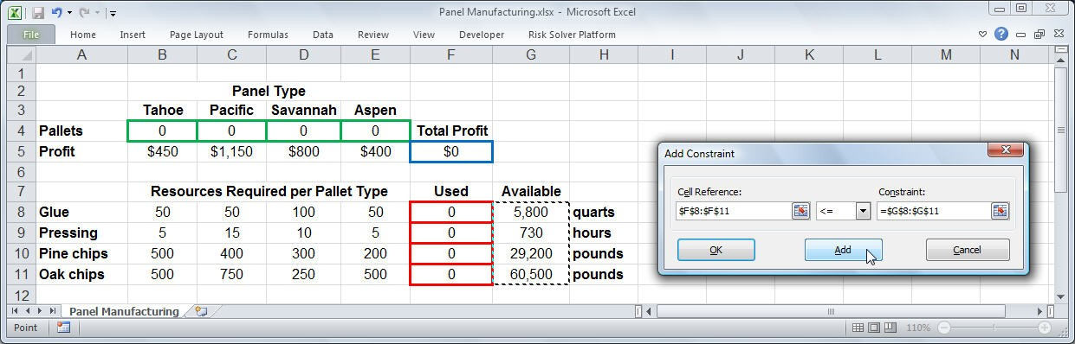

Slide 29
We choose the Add button again (either from the Add Constraint dialog above, or from the main Solver Parameters dialog) to define the non-negativity constraint on the decision variables.

Slide 30
Finding and Using the Solution
To find the optimal solution, we simply click on the Solve button. After a moment, the Excel Solver returns the optimal solution in cells B4 through E4.
This means that we should build 23 pallets of Tahoe panels, 15 pallets of Pacific panels, 39 pallets of Savannah panels, and 0 pallets of Aspen panels. This results in a total profit of $58,800 (shown in cell F5).

Slide 31
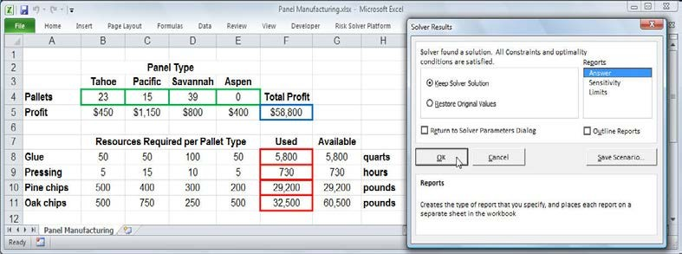

Slide 32
Step 3.Solving the Problem(libre office)
Now we'll start the LibreOffice Solver and insert the Target Cell, Desired result, the Cells that needs changing and the Limiting Conditions. Cell locations are given just as an indication on how to use Libre Office. Follow the same procedure as previously to solve the problem.
Cell D14 is your objective function will change (Target Cell ) as the solver changes to 0 or 1 in cell range C8:C13.
Changes in the cell range C8:C13 makes Solver check if D14 has the same value as B2. Limiting conditions are your constraints.
Have a look at the following figure to see the logic of the solver.

Slide 33
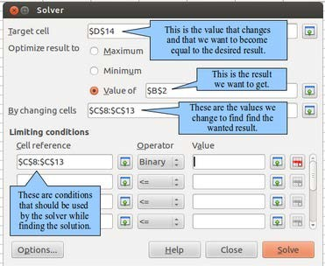

Slide 34
linear programming Case studies

